Slide 1


HOPE and HEALING GRIEF
HopeHealingGrief.org

Slide 2
Welcome to Hope and Healing Grief
Do we have a volunteer to chair today? I can run the PowerPoint.
At the end of this meeting, we’ll ask if someone will chair next week’s meeting.
Welcome to the [NAME OF MEETING] of Hope and Healing Grief. My name is ___, and I am living in hope and healing.
This is a closed meeting for those seeking healing from grief or those exploring whether this path may be helpful for them. We ask that everyone keep their camera on during the meeting, as shared visibility helps create safety, presence, and connection for everyone here. If you’re unable to keep your camera on, please let the host know.
Hope and Healing Grief is non-professional. It is not therapy, offers no treatment, and is not advice-giving. We share our own experience and listen with respect. Hope and Healing Grief is not a social club or a place for dating. If anyone approaches you in a way that feels inappropriate, we encourage you to share this with the chairperson or another trusted member.
If you are new to Hope and Healing Grief, we encourage you to attend at least 6 meetings to see if this program is right for you.
What is shared here is held in confidence, and all people and beliefs are welcome.
May I have a volunteer read The Preamble?

Slide 3
Meeting Preamble
We gather as equals, guided by compassion as we navigate the pain of loss. No grief is too small to be felt or too great to heal. Here, no one grieves alone.
We heal individually through the Twelve Truths and create hope collectively through the Twelve Tenets. With no governing leaders, we follow collective wisdom rather than individual will.
Anonymity encourages honesty and protects what is shared. Hope and Healing Grief is inspired by the Twelve Steps of Alcoholics Anonymous, but is a softer, gentler path created specifically for those navigating loss.
All who seek relief from grief are welcome here, exactly as we are and wherever we are on our healing journeys.
Thank you. We will now read the 12 Truths of Hope and Healing Grief. I’ll read the first two and I ask others to read two after me.

Slide 4
12 Truths of Hope and Healing Grief
1. We became honest with our grief – acknowledging that its pain was shaping our lives.
2. Came to believe that compassion and connection with ourselves, others, and a power greater than ourselves could restore our hope in a better tomorrow.
3. Made a decision to open our hearts to healing, trusting that life could hold meaning beyond our sorrow.
4. Courageously took an honest look at our grief – its roots, its weight, and the many losses we carried.
5. Shared our realizations and understandings with ourselves, another person, and our Higher Power.
6. Became willing to let go of the beliefs, regrets, and expectations that kept us tied to our pain.
7. Humbly invited hope, love, and resilience to heal the broken places within us.
8. Made a list of all those our grief had distanced us from – including ourselves – and became willing to reconnect.
9. Extended compassion and made amends where possible, recognizing that grief is a universal human experience deserving of gentleness.
10. Committed to regular reflection, self-care, and honesty to continue nurturing our healing.
11. Sought through mindfulness, meditation, and prayer to deepen our sense of connection with life, love, meaning, and hope.
12. Having experienced hope and healing, we shared this gift with others who grieve – reminding them that no one has to heal alone.

Slide 5
Introductions
Now is the time for introductions.
Are there any newcomers here today?
[IF SO] Please introduce yourself by your first name only so that we may welcome you.
[NEWCOMER(S) INTRODUCTIONS]
Welcome. Everyone here will have a chance to share today, so if you’d like to tell us more about your story you may do so later. But there is no requirement for anyone to speak at any time.
Let’s all take a moment to introduce ourselves, speaking as the spirit moves us. My name is ______ and I am here for hope and healing. [OTHERS INTRODUCE THEMSELVES]

Slide 6
Business Meeting
The first week of each month, we have a brief business meeting following the close of that week’s meeting. All are welcome, everyone is encouraged to attend, and everyone’s voice matters.
Announcements
Are there any announcements?

Slide 7

Moments of Hope and Healing
Gratitude and Remembrance
This is the time of the meeting when we pause to honor moments of hope, healing, gratitude, or remembrance that feel meaningful this week. If you’d like to share a moment, we ask that you keep it to a sentence or two. Sharing is optional, and everyone will have an opportunity to share at length later in the meeting.
Would anyone like to share a moment?

Slide 8
WEEKLY TOPIC / LEAD
The 1st week of the month, we either have a lead or read the 12 Ways Grief Impacts Our Life.
If there is a lead, we ask that it be a personal story of experience, strength, and hope and is limited to 15 minutes.
Since this is the first week of the month, do we have a volunteer to give a lead? [IF SO] Thank you, NAME. Is someone willing to serve as timer? [IF SO] Thank you, NAME. May we hear the time’s up sound or see the time’s up warning]. Our timer will give a 5-minute warning. Please help me welcome, [LEAD VOLUNTEER]
The 2nd week of the month, we read the 12 Signs of Feeling Hope and Healing from Grief.
On the 3rd week of the month we select 3 topics from the 100 Topics for Hope and Healing Grief. to inspire reflection and shares, with three attendees each selecting a number from 1 to 100.
The 4th week of each month, we read the 12 Signs of Growth from Grief.
And if there’s a 5th week of the month, we read the 12 Spiritual Principles of Hope and Healing Grief.

Slide 9
1st Week – 12 Ways Grief Impacts Our Life - 1/2
Grief can impact our life in many ways. These twelve reflect some of the most common ways it shows up. I’ll read the first two and ask others to read two after me.
1. Preoccupation With What We Have Lost – We constantly think about the person or thing that was lost, leading to difficulty focusing on other aspects of our life.
2. Avoidance of New Relationships or Experiences – We fear that doing so would betray the memory of what was lost or that history would painfully repeat itself.
3. Emotional Numbing – Our relentless focus on what we have lost suppresses our emotions, disconnecting us from ourselves and others.
4. Idealization of the Lost – We view what we have lost through an overly positive lens, often minimizing any of its flaws or challenges.
5. Self-Isolation – We withdraw from social connections to continue privately focusing on our grief in order to avoid confronting reminders of moving on.
6. Inability to Imagine the Future – We are unable to envision or plan for a future that doesn’t include what we have lost

Slide 10
1st Week – 12 Ways Grief Impacts Our Life - 2/2
7. Seeking Substances or Behaviors for Comfort – We use substances and behaviors to soothe our pain, sometimes in ways that become obsessive or harmful.
8. Guilt or Self-Blame – We feel responsible for our loss or feel guilty for not being able to “move on.”
9. Obsessive Revisiting of Memories – We obsessively revisit photos, places, or items associated with our loss, reinforcing our sadness and pain.
10. Physical Symptoms – We experience sleeplessness, fatigue, anxiety, or panic attacks as physical manifestations of our grief.
11. Attachment to Pain – We become attached to our grief, fearing that releasing it would mean losing our connection to what we have lost.
12. Resistance to Closure – We avoid rituals, conversations, or personal growth work that could bring closure, believing doing so would diminish the meaning of our loss.

Slide 11
7th Tenet
Before we begin the sharing portion of the meeting, in accordance with the 7th Tenet, each meeting is “sustained by voluntary member contributions.” Contributions support the meeting domain and website, web hosting, and other program expenses. Please give what you can. And if you can’t, no problem, keep coming back. We need you more than we need your money. Newcomers please be our guest. We’re just glad you’re here. The Venmo code will be placed in chat during the sharing portion of the meeting.

Slide 12
2nd Week - 12 Signs of Feeling Hope and Healing from Grief - 1/2
I’ll read the first two and ask others to read two after me.
Acceptance: We acknowledge our loss and are grateful for the willingness to face it.
Awareness: We have developed a greater understanding of our emotions and how to express them.
Reconnection: We connect with ourselves and others in ways that feel genuine and meaningful.
Self-Care: We prioritize our own well-being, knowing we must first care for ourselves before we can care for others.
Surrender: We trust the process of healing, knowing it unfolds whenever honesty and willingness are present.
Boundaries: We establish and maintain healthy boundaries, giving ourselves the time and space needed to heal and grow.
Forgiveness: We forgive ourselves and others, knowing that resentment is an unnecessary burden on our healing.
Support: We actively seek support and offer it to others.

Slide 13
2nd Week - 12 Signs of Feeling Hope and Healing from Grief - 1/2
Spirit: Through our healing, we enliven the best of our spirit and the world around us.
Presence: We focus on living in this moment and celebrate the abundance that fills each day, recognizing that our loss, though it may still be with us, belongs more to our past than our future.
Hope: With new-found perspective, we look forward to tomorrow, knowing that healing is possible even within our grief.
Service: We give back what we have freely received so that others may also live their best journey as they go — and grow — through grief.

Slide 14
3rd Week – 100 Topics
Acceptance
Acts of Kindness in Grief
Aging and Loss
Anger in Grief
Asking for Help
Beauty in Brokenness
Being Present
Betrayal and Healing
Blessings in Disguise
Body Image and Grief
Boundaries in Grief
Breath as a Healing Tool
Caregiving Losses
Change and Transition
Childhood Grief
Choices in Healing
Chronic Sorrow
Compassion for Ourselves
Community Support
Coping with Holidays
Courage to Grieve
Creating New Traditions
Creative Expression in Grief
Death of a Dream
Denial and Avoidance
Depression in Grief
Disenfranchised Grief
Displacement and Loss
Dreams of Those We’ve Lost
Emotional Honesty
Endings and Beginnings
Estrangement
Faith in Darkness
Family Expectations
Fear of Future Loss
Finding Gratitude
Finding Meaning After Loss
Finding Meaning After Loss
Forgiveness
Friendship in Grief
Guilt in Grief
Grieving a Lost Future
Grieving as a Process
Grieving Changes in Identity
Grieving Unmet Expectations
Grief and Addiction
Grief and Anxiety
Grief and Creativity
Grief and Spirituality
Grief Rituals
Growth Through Loss
Healing in Community
Healing Through Connection

Slide 15
3rd Week – 100 Topics
Healing Through Creativity
Healing Through Faith
Healing Through Movement
Healing Through Music
Healing Through Service
Hope in Hard Times
Hope Restored
Honoring Memories
Inner Strength
Invisible Grief
Isolation in Grief
Joy After Loss
Keeping Memories Alive
Letting Go vs. Holding On
Life After Loss
Living With Unanswered Questions
Loneliness
Loss of a Pet
Loss of Control
Loss of Faith
Loss of Home or Community
Loss of Identity
Loss of Innocence
Loss of Security
Loving Through Pain
Making Amends
Making Meaning of Loss
Men and Grief
Milestones and Anniversaries
Moving Forward With Grief
Navigating Family Dynamics
Navigating New Roles
Newfound Strength
Numbness and Disconnection
One Day at a Time
Opening the Heart
Overcoming Fear
Patience With the Process
Permission to Grieve
Physical Symptoms of Grief
Practicing Self-Compassion
Rebuilding Hope
Rediscovering Joy
Resilience in Loss
Rituals for Remembrance
Signs and Symbols
Trust the Journey

Slide 16
4th Week - 12 Signs of Growth from Grief - 1/2
I’ll read the first two and ask others to read two after me.
1. Accepting Reality: We accept the truth of our loss and acknowledge the pain it brings, without denying or avoiding the emotions that arise.
2. Emotional Regulation: We practice healthy ways to express and calm our emotions, managing distress without self-destructive behaviors.
3. Seeking Support: We reach out to trusted friends, family, or communities for understanding, connection, and shared healing.
4. Setting Boundaries: We set and maintain boundaries that protect our emotional well-being, stepping back from people or situations that deepen our pain.
5. Engaging in Self-Care: We prioritize practices that nurture physical, emotional, and spiritual health.
6. Finding Meaning and Purpose: Through creativity, relationships, and service, we rediscover meaning and purpose beyond loss.
7. Cultivating Resilience: We recognize grief as a natural part of being human, but not the definition of who we are or what lies ahead.
8. Living in the Present: We celebrate life by noticing joy and gratitude in the present moment, rather than dwelling in the past or fearing the future.

Slide 17
4th Week - 12 Signs of Growth from Grief - 2/2
9. Practicing Forgiveness: We forgive ourselves and others, releasing resentment and anger that block our healing.
10. Continuous Growth and Learning: We open to new experiences, deepening wisdom through challenges and celebrating progress along the way.
11. Honoring the Memory: We cherish the memories of what we grieve, welcoming them as a reflection of love that endures and expands.
12. Serenity: We are at peace with ourselves and the world around us, knowing that, in this moment we are just where we need to be.

Slide 18
5th Week - 12 Spiritual Principles of Hope and Healing Grief
The 12 Spiritual Principles of Hope and Grief are the essence of each of the 12 Truths. In our healing, we discovered that they are a powerful tool to both heal grief and to live a fuller life. I’ll read the first two and ask others to read two after me.
1. Acceptance
By accepting that we alone cannot stop our pain we are ready to reach out for the support of others.
2. Hope
We came to believe that compassion and connection with others could help restore our hope for a better tomorrow.
3. Faith
We placed our trust in the belief that life could hold meaning beyond our sorrow.
4. Courage
As we courageously explored our grief in detail, we discovered that the loss that prompted us to begin our recovery journey was one of many that affected us.
5. Honesty
We experienced that honestly sharing our realizations and understandings with ourselves, others, and our Higher Power is not just freeing, it is life changing.
6. Willingness
A willingness to let go of the beliefs, regrets, and expectations that kept us tethered to our pain was the true beginning of healing.

Slide 19
5th Week - 12 Spiritual Principles of Hope and Healing Grief
7. Humility
We humbly reached out to others for support in replacing our broken places with hope and light.
8. Love
With love we connected to those – including ourselves – our grief had prompted us to push away.
9. Forgiveness
Knowing that grief is part of the human experience, we are gentle as we reconnect with those our grief has distanced us from. Especially ourselves.
10. Perseverance
We continually exercise our spiritual muscle so we may live our life fully and be of the greatest service to others.
11. Awareness
We regularly find quiet moments to become mindful, meditate, or pray as we seek the next right thing to do to continue to grow our healing journey.
12. Service
Our journey of spiritual awakening has been supported by many. We bring our hard-earned hope and healing to all areas of our lives and share it with those who still suffer in their grief, assuring them they are not alone.

Slide 20
Sharing
This is the time of the meeting when we share. In sharing, we focus on the reading, topic, or lead, and our journey of hope and healing. We avoid crosstalk, which means we do not comment directly on another group member's comments. If anyone is uncomfortable with another person’s share, they may quietly raise their hand, and the speaker is asked to respect this person’s discomfort. Please keep shares to 3 minutes or less. A timer will sound when three minutes are up.
[IF NO TIMER FOR A LEAD] May we have a volunteer to be timer? Thank you, [NAME]. May we hear the times up sound? [OR SEE THE TIMES UP SIGN] Thank you.
Shares will end 10 minutes prior the meeting’s close to allow for burning desires and closing readings. The floor is now open for comments.

Slide 21

10 Minutes Before Meeting Close
It’s now 10 minutes before the meeting’s close. Are there any newcomers who haven’t yet had a chance to speak and would like to? Are there any one-minute burning desires?

Slide 22
Meeting Close
This brings us to the close of today’s meeting. We remind you that everything shared here has been said in confidence. We would like someone to volunteer to chair next week’s meeting. If you do, you don’t need to start the Zoom meeting but simply read the meeting script and serve as the meeting chair. Do we have a volunteer to serve as the chair of next week’s meeting?
Would someone please read the Promises of Hope and Healing Grief?
PROMISES OF HOPE AND HEALING GRIEF
If we are honest, open, and willing on our healing path, we will come to know acceptance. We will learn to face our grief without fear. Hope will awaken within us, and we will learn to trust life again. Our hearts, once closed, will find faith in what is possible. New courage will emerge, and we will begin to grow in places that once felt barren.
By sharing our stories and listening to others, we will feel heard and understood. As we release guilt, regret, and expectations that no longer serve our healing, freedom and compassion will gently return.
Renewal and purpose will take root. We will reconnect with ourselves and with others and rediscover our capacity for love. Having experienced hope and healing, we will share these gifts with those who still grieve, becoming reminders that no one heals alone.
These are not extravagant promises; they unfold among us when we work for them — one day at a time.

Slide 23
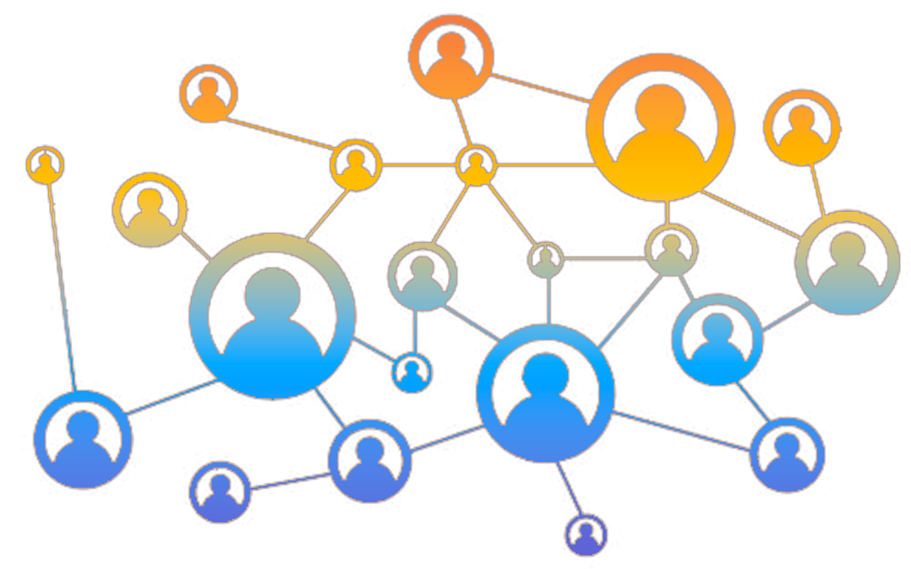
Fellowship
This has been the [DAY / TIME] weekly meeting of Hope and Healing Grief.
The chat will be open for Fellowship for the next fifteen minutes. Please only share personal details with those who feel safe for you.
Thank you for being here today. We wish you hope and healing.

Slide 24
HOPE and HEALING GRIEF
HopeHealingGrief.org

